Slide 1
Analysis of Algorithms
CS 302 - Data Structures
Section 2.6

Slide 2
Analysis of Algorithms
What is the goal?
Analyze time requirements - predict how running time increases as the size of the problem increases:
Why is it useful?
To compare different algorithms.
time = f(size)

Slide 3
Defining “problem size”
Typically, it is straightforward to identify the size of a problem, e.g.:
  size of array
  size of stack, queue, list etc.
  vertices and edges in a graph
But not always …

Slide 4
Time Analysis
  Provides upper and lower bounds of running time.
Different types of analysis:
  - Worst case
  - Best case
  - Average case

Slide 5
Worst Case
Provides an upper bound on running time.
An absolute guarantee that the algorithm would not run longer, no matter what the inputs are.

Slide 6
Best Case
Provides a lower bound on running time.
Input is the one for which the algorithm runs the fastest.

Slide 7
Average Case
Provides an estimate of “average” running time.
Assumes that the input is random.
Useful when best/worst cases do not happen very often (i.e., few input cases lead to best/worst cases).

Slide 8
Example: Searching
Problem of searching an ordered list.
  Given a list L of n elements that are sorted into a definite order (e.g., numeric, alphabetical),
  And given a particular element x,
  Determine whether x appears in the list, and if so, return its index (i.e., position) in the list.

Slide 9
Linear Search
procedure linear search
(x: integer, a₁, a₂, …, a_{n}: distinct integers)
i := 1
while (i ≤ n ∧ x ≠ a_{i})
i := i + 1
if i ≤ n then location := i
else location := 0
return location
NOT EFFICIENT!

Slide 10
How do we analyze an algorithm?
Need to define objective measures.
(1) Compare execution times?
Not good: times are specific to a particular machine.
(2) Count the number of statements?
Not good: number of statements varies with programming language and programming style.

Slide 11
Example
Algorithm 1 Algorithm 2
arr[0] = 0; for(i=0; i<N; i++)
arr[1] = 0; arr[i] = 0;
arr[2] = 0;
...
arr[N-1] = 0;

Slide 12
How do we analyze an algorithm? (cont.)
(3) Express running time t as a function of problem size n (i.e., t=f(n) ).
  Given two algorithms having running times f(n) and g(n), find which functions grows faster.
  - Such an analysis is independent of machine time, programming style, etc.

Slide 13
How do we find f(n)?
(1) Associate a "cost" with each statement.
(2) Find total number of times each statement is executed.
(3) Add up the costs.
Algorithm 1 Algorithm 2
Cost Cost
arr[0] = 0; c₁ for(i=0; i<N; i++) c₂
arr[1] = 0; c₁ arr[i] = 0; c₁
arr[2] = 0; c₁
...
arr[N-1] = 0; c₁
----------- -------------
c₁+c₁+...+c₁ = c₁ x N (N+1) x c₂ + N x c₁ =
(c₂ + c₁) x N + c₂

Slide 14
How do we find f(n)? (cont.)
Cost
sum = 0; c₁
for(i=0; i<N; i++) c₂
for(j=0; j<N; j++) c₂
sum += arr[i][j]; c₃
------------
c₁ + c₂ x (N+1) + c₂ x N x (N+1) + c₃ x N x N

Slide 15
Comparing algorithms
  Given two algorithms having running times f(n) and g(n), how do we decide which one is faster?
Compare “rates of growth” of f(n) and g(n)

Slide 16
Understanding Rate of Growth
Consider the example of buying elephants and goldfish:
Cost: (cost_of_elephants) + (cost_of_goldfish)
Approximation:
Cost ~ cost_of_elephants

Slide 17
Understanding Rate of Growth (cont’d)
The low order terms of a function are relatively insignificant for large n
n⁴ + 100n² + 10n + 50
Approximation:
n⁴
Highest order term determines rate of growth!

Slide 18
Example
Suppose you are designing a website to process user data (e.g., financial records).
Suppose program A takes f_{A}(n)=30n+8 microseconds to process any n records, while program B takes f_{B}(n)=n²+1 microseconds to process the n records.
Which program would you choose, knowing you’ll want to support millions of users?
A
Compare rates of growth:
30n+8 ~ n and n²+1 ~ n²

Slide 19
Visualizing Orders of Growth
On a graph, as
you go to the
right, a faster
growing
function
eventually
becomes
larger...
f_{A}(n)=30n+8
Value of function →
f_{B}(n)=n²+1
Increasing n →

Slide 20

Rate of Growth ≡Asymptotic Analysis
Using rate of growth as a measure to compare different functions implies comparing them asymptotically (i.e., as n → )
If f(x) is faster growing than g(x), then f(x) always eventually becomes larger than g(x) in the limit (i.e., for large enough values of x).

Slide 21
Asymptotic Notation
O notation: asymptotic “less than”:
  f(n)=O(g(n)) implies: f(n) “≤” c g(n) in the limit*
c is a constant
(used in worst-case analysis)
*formal definition in CS477/677

Slide 22
Asymptotic Notation
Ω notation: asymptotic “greater than”:
  f(n)= Ω (g(n)) implies: f(n) “≥” c g(n) in the limit*
c is a constant
(used in best-case analysis)
*formal definition in CS477/677

Slide 23
Asymptotic Notation
Θ notation: asymptotic “equality”:
  f(n)= Θ (g(n)) implies: f(n) “=” c g(n) in the limit*
c is a constant
(provides a tight bound of running time)
(best and worst cases are same)
*formal definition in CS477/677

Slide 24
Big-O Notation - Examples
f_{A}(n)=30n+8
f_{B}(n)=n²+1
10n³ + 2n²
n³ - n²
1273
is O(n)
is O(n²)
is O(n³)
is O(n³)
is O(1)

Slide 25
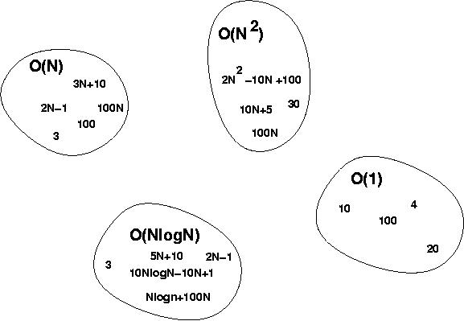
More on big-O
O(g(n)) is a set of functions f(n)
f(n) ϵ O(g(n)) if “f(n)≤cg(n)”

Slide 26
Big-O Notation - Examples
f_{A}(n)=30n+8 is O(n)
f_{B}(n)=n²+1 is O(n²)
10n³ + 2n² is O(n³)
n³ - n² is O(n³)
1273 is O(1)
or O(n²)
or O(n⁴)
But it is important to
use as “tight” bounds
as possible!
or O(n⁴)
or O(n⁵)
or O(n)

Slide 27
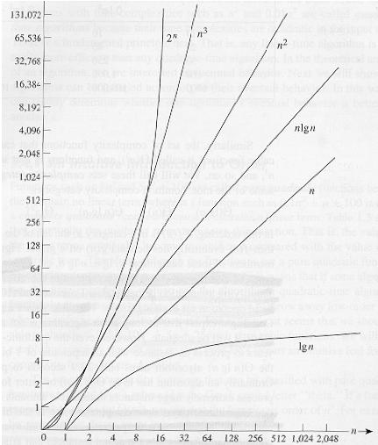
Common orders of magnitude

Slide 28
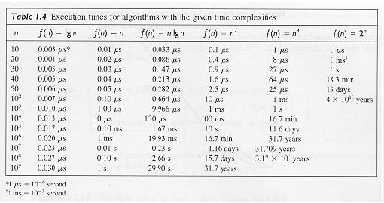

Slide 29
Algorithm speed vs function growth
An O(n²) algorithm will be slower than an O(n) algorithm (for large n).
But an O(n²) function will grow faster than an O(n) function.
f_{A}(n)=30n+8
Value of function →
f_{B}(n)=n²+1
Increasing n →

Slide 30
Estimating running time
Algorithm 1 Algorithm 2
Cost Cost
arr[0] = 0; c1 for(i=0; i<N; i++) c2
arr[1] = 0; c1 arr[i] = 0; c1
arr[2] = 0; c1
...
arr[N-1] = 0; c1
----------- -------------
c1+c1+...+c1 = c1 x N (N+1) x c2 + N x c1 =
(c2 + c1) x N + c2
O(N)

Slide 31
Estimate running time (cont.)
Cost
sum = 0; c1
for(i=0; i<N; i++) c2
for(j=0; j<N; j++) c2
sum += arr[i][j]; c3 ------------
c1 + c2 x (N+1) + c2 x N x (N+1) + c3 x N x N
O(N²)

Slide 32
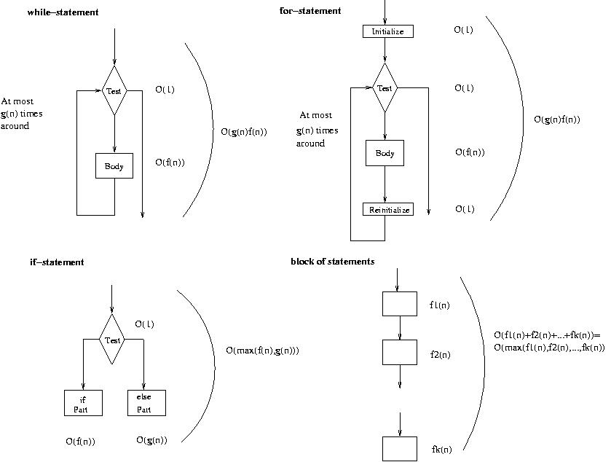
Running time of various statements
while-loop
for-loop

Slide 33
Examples
i = 0;
while (i<N) {
X=X+Y; // O(1)
result = mystery(X); // O(N), just an example...
i++; // O(1)
}
The body of the while loop: O(N)
Loop is executed: N times
N x O(N) = O(N²)

Slide 34
Examples (cont.’d)
if (i<j)
for ( i=0; i<N; i++ )
X = X+i;
else
X=0;
Max ( O(N), O(1) ) = O (N)
O(N)
O(1)

Slide 35
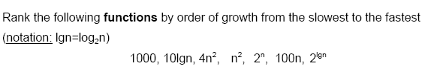

Examples (cont.’d)

Slide 36

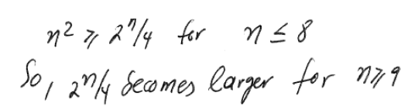
Examples (cont.’d)

Slide 37
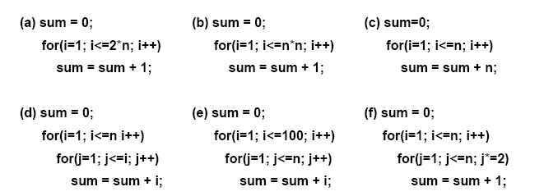
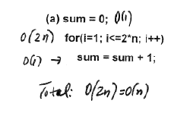
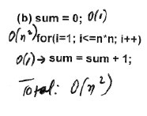
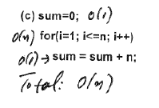
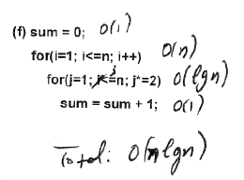
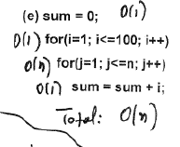
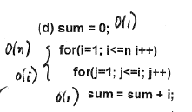
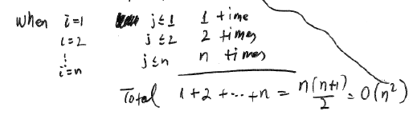
Examples (cont.’d)
Analyze the complexity of the following code segments:

